Slide 1
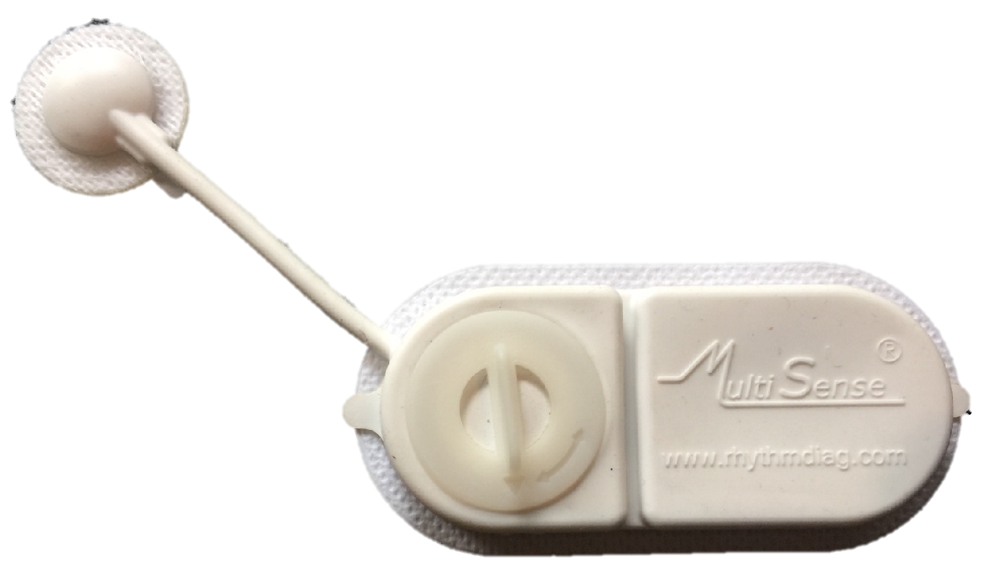
Rhythm Diagnostic Systems : wearable medical devices for continuous monitoring of patients’ vital signs march 2021, long presentation

Slide 2
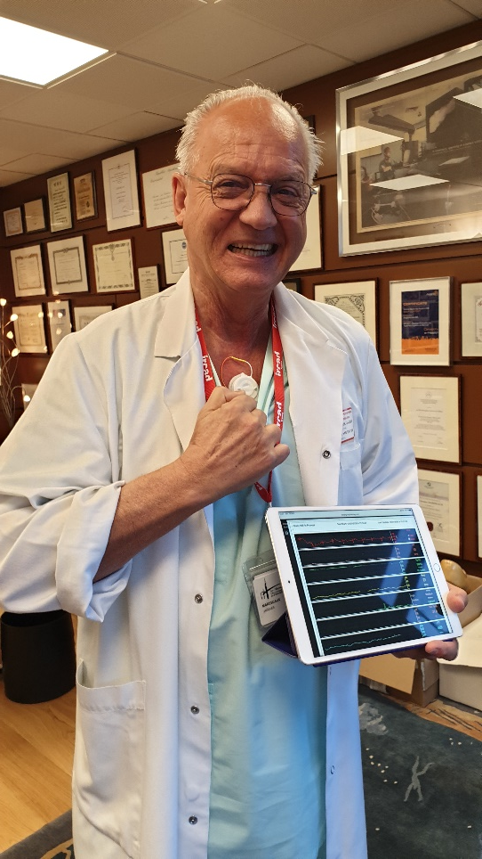
From Palo Alto to Strasbourg
2020
RDS Inc
RDS SAS
Five years of work by a team of R&D engineers led by Dr Sam Eletr : turning the vision into a fully functional prototype
From the prototype to the product : design optimization, manufacturing processes, clinical validation, CE and FDA approval, marketing
Strasbourg IHU and IRCAD institutional support
Personal involvement of Pr Marescaux
World class scientific environment already connected to Sam Eletr
Availability of highly qualified resources
French Tech : a highly dynamic and supportive economic environment
Fostered by « Tomorrow’s Health Territory » / Hospitel flagship project

Slide 3
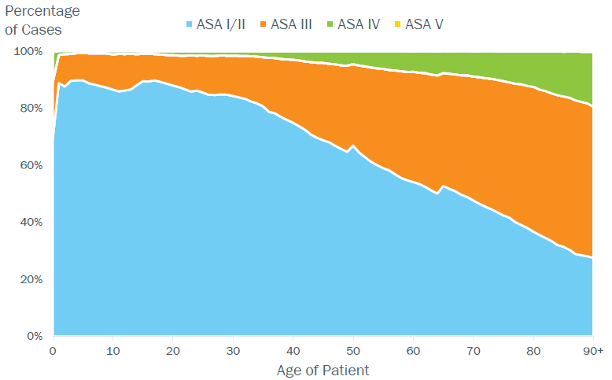
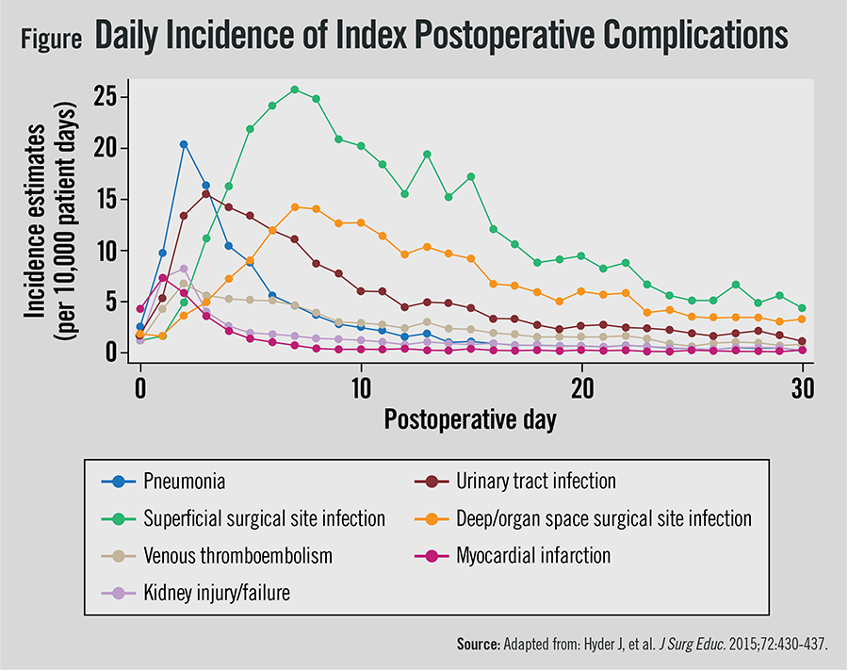
A huge need to facilitate the monitoring of patients in a context where more are sent home earlier.
300 million surgeries performed each year worldwide (30m in Europe & 30m in the US)
30% of patients are “at risk” (10m in EU & 10m in US) and 10 to 15% will have a complication ☹
But keeping them in the hospital after surgery (SoC) is not a good solution !
Early discharge is beneficial for patients & healthcare systems ^{(*)}. It requires protocols and telemonitoring.
(*) Cost of a day in Hospital : from 1 370 € in medical departments to 3 000 € in ICU (France)
https://tsaco.bmj.com/content/3/1/e000219;
https://www.ncbi.nlm.nih.gov/pmc/articles/PMC4825673/
Notes:
ASA I : no systemic disease
ASA II : mild systemic disease
ASA III : severe systemic disease
ASA IV : severe systemic disesase constant threat to life
ASA V : not expected to survive surgery
https://www.ncbi.nlm.nih.gov/pmc/articles/PMC4825673/
Respiratory arrests, especially in unmonitored settings, are among the most serious complications after noncardiac surgery.¹ Respiratory arrests are difficult to study² because they are fortunately rare. It is likely, however, that respiratory arrests are preceded by respiratory insufficiency³ as might be indicated by reduced oxyhemoglobin saturation (Sp_{O2}).⁴ Even if hypoxemia does not lead to respiratory arrest, it is a strong indicator of patient instability, compromises wound healing,^{5–7} and promotes other serious complications, including brain dysfunction,^{8,9} dysrhythmias,¹⁰ and myocardial ischemia.^{11–13}
Les analyses faites ces dernières années sur le prix d’une hospitalisation démontrent qu’une journée d’hospitalisation coûte en moyenne 1370 € dans un service de médecine ; 1700 € dans un service de chirurgie et plus de 3000 € en soins intensifs !

Slide 4
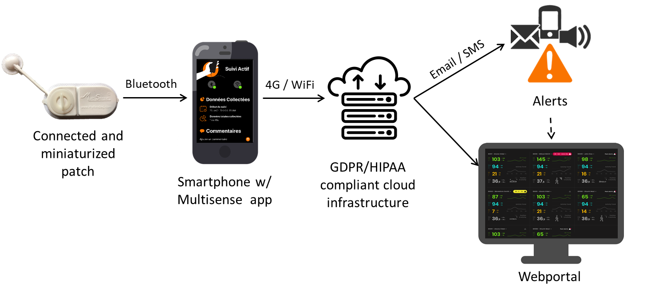
Multisense®: a global monitoring solution in and out of the hospital
Clinical-grade, real-time, continuous monitoring
Pre-industrial version
notifications
Early detection of patient deterioration / onset of complications
(in process of CE mark, class IIA)
Notes:
Problème avec cette image dont je n’ai pas la source

Slide 5
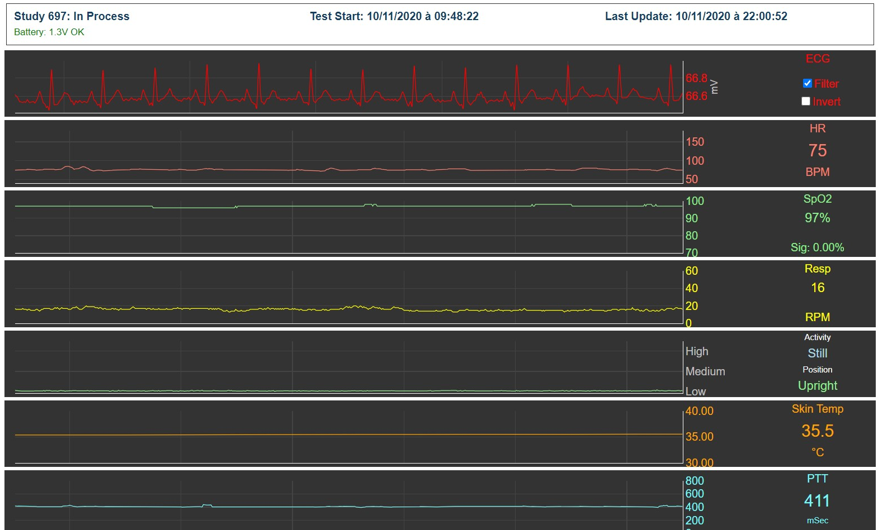
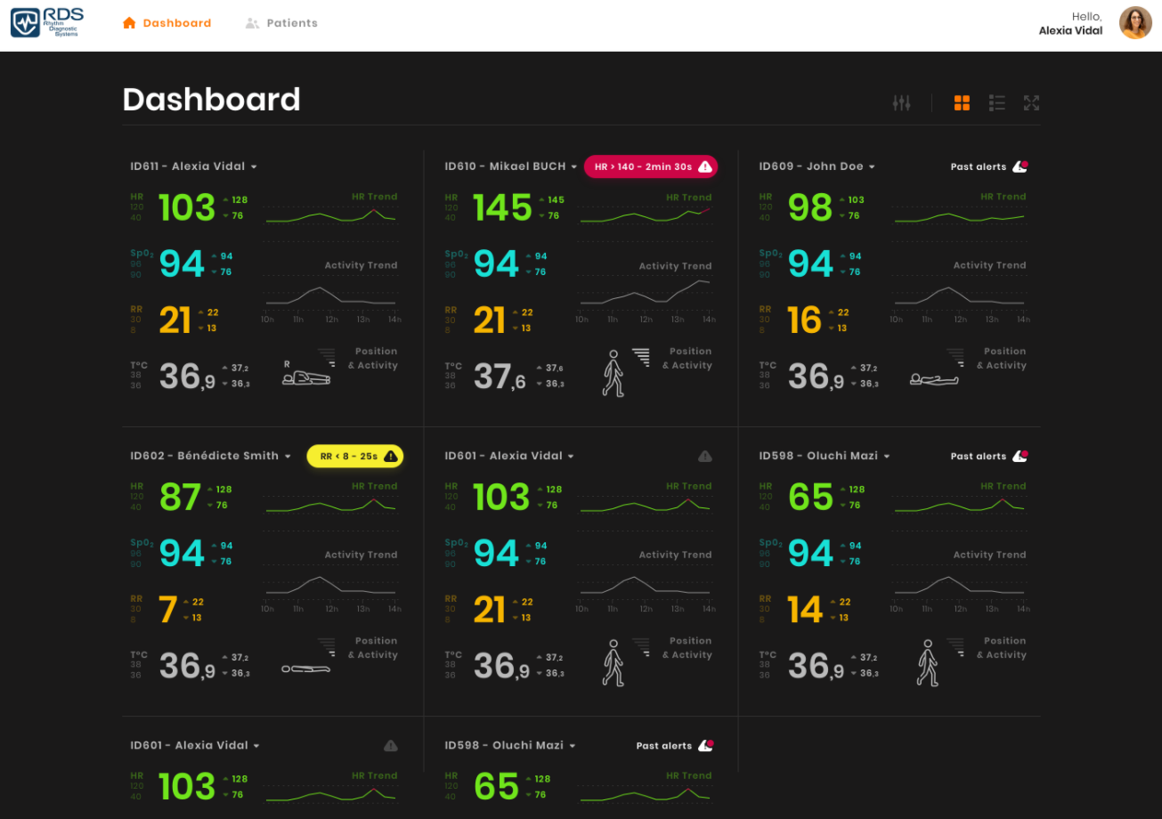
One-week long continuous, real time HR, RR, activity, and SpO2 monitoring
Global view with notifications

Slide 6
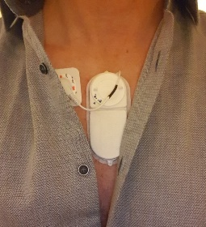
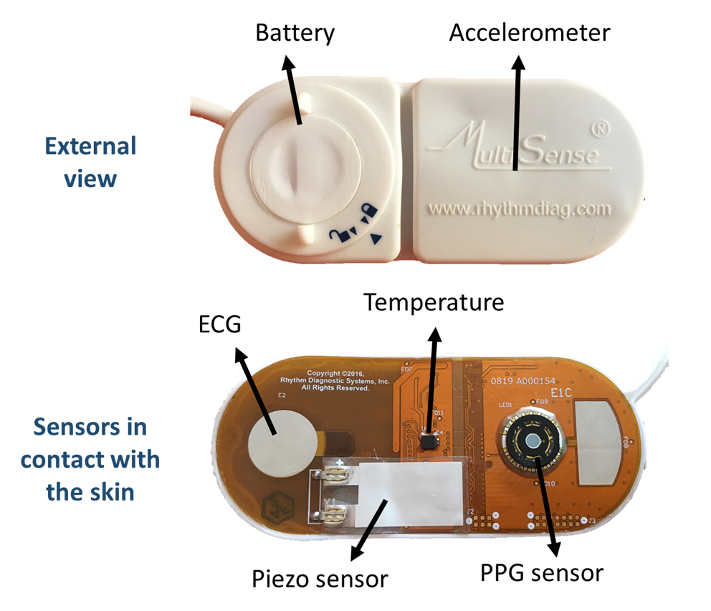
A dense array of patented micro-electronics and signal processing methods brought together in Multisense®
ECG (single-lead)
Heart rate
5-7 days
Respiration rate
continuous (BLE connected)
15g
Oxygen saturation (SpO2)
All skin colors
Bluetooth antenna
4 x 8.5 cm
Skin temperature
Flexible
Activity & posture
(adhesive removed)
Water-resistant
Blood pressure variations
(in development)
Notes:
Need to add adhesive info, besoin de l’image originale

Slide 7
First clinical trials are under way with IHU Strasbourg
Name | Indication | Type | N° patients | Investigation centers | Regulatory Authorization | Patients inclusion
REDASUR clinicaltrials.gov/ NCT04480385 | Post-Surgery Monitoring | Faisability | 60 | Strasbourg
MONIREA clinicaltrials.gov/ NCT04661423 | Post-ICU Monitoring | Faisability | 60 | Strasbourg and Nancy
Monitoring
Primary Objective | Evaluate the relevance and reliability of the MultiSense® Patch
Endpoint | Quality of measurements of clinical signs provided by MultiSense®-Strip in comparison to measurements made with conventional medical device in the hospital setting (accuracy, connectivity, generation of artifactual data and stability of data transmission)

Slide 8
« Machine learning that matters »
Collecting data and/or applying machine learning methods doesn’t automatically create value for society:
Find a real problem;
Collect meaningful data;
Make sure you can actually use the data;
Use meaningful evaluation methods.

Slide 9
1. Find a real problem
You may consider droping the project if you answer no to one of the following questions:
Do I know what I am trying to predict and why?
Is my prediction relatively obvious to an expert?
Is the observations/variables large enough?
Do I know how much predictive power is meaningful?
If I can predict reasonably well
Will any one be interested?
Will it be made available?
Wagstaff, Kiri. "Machine learning that matters." arXiv preprint arXiv:1206.4656 (2012).

Slide 10
2. Collect meaningful data
Use a variety of available datasets :
synthetic datasets for prototyping;
Benchmark data set for model calibration;
Always alternative data source for validation.
If collect your own data, think about how transferable your results will be in terms of:
Population: demographics, ethnicity, comorbidities, seasonality ;
Set-up: sampling rate, sensors, calibration,…;
Environment: noise (main line)
Alway provision an external source of data for validation.
And carefully consider collecting:
meaningful contextual data (pre-existing conditions, past interventions);
Meaningful outcomes:

Slide 11
3. Make sure you can actually use the data
Have data doesn’t automatically grants you rights on it.
Check GDPR rules
Get conscent
Get CNIL autorisation
Remember than anonymisation of data is a processing.
There is no point to collecting data if you don’t have a decent path to using it for your research/project.

Slide 12
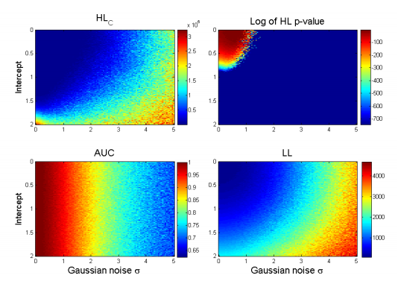
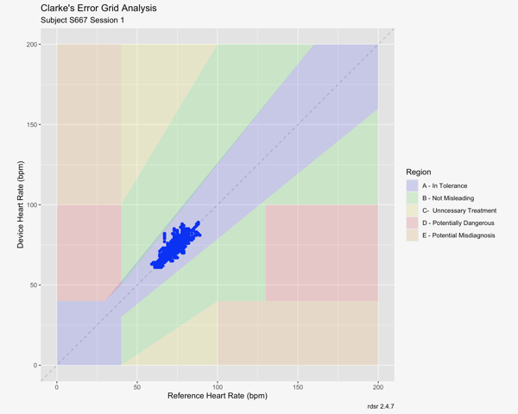
Use meaningful evaluation methods
Select the appropriate method for:
Optimization Evaluation
Mayaud, Louis. Prediction of mortality in septic patients with hypotension. Diss. University of Oxford, 2014.
Clarke, W. L. (2005). The original Clarke error grid analysis (EGA). Diabetes technology & therapeutics, 7(5), 776-779.

Slide 13
We are proudly supported by

Slide 14
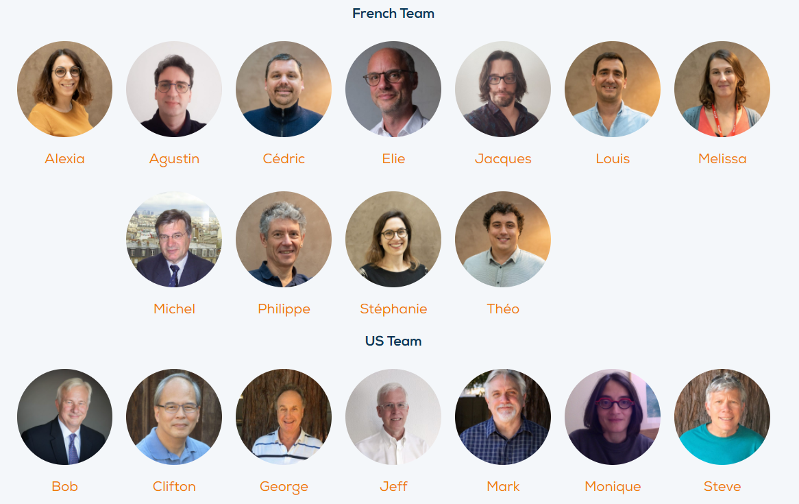
Our talented French-American team with multiple expertise
Also, we’re hiring!

Slide 15
Thank you for your attention !
www.rdsdiag.com
Elie LOBEL
CEO
elie.lobel@rdsdiag.com

